Slide 1
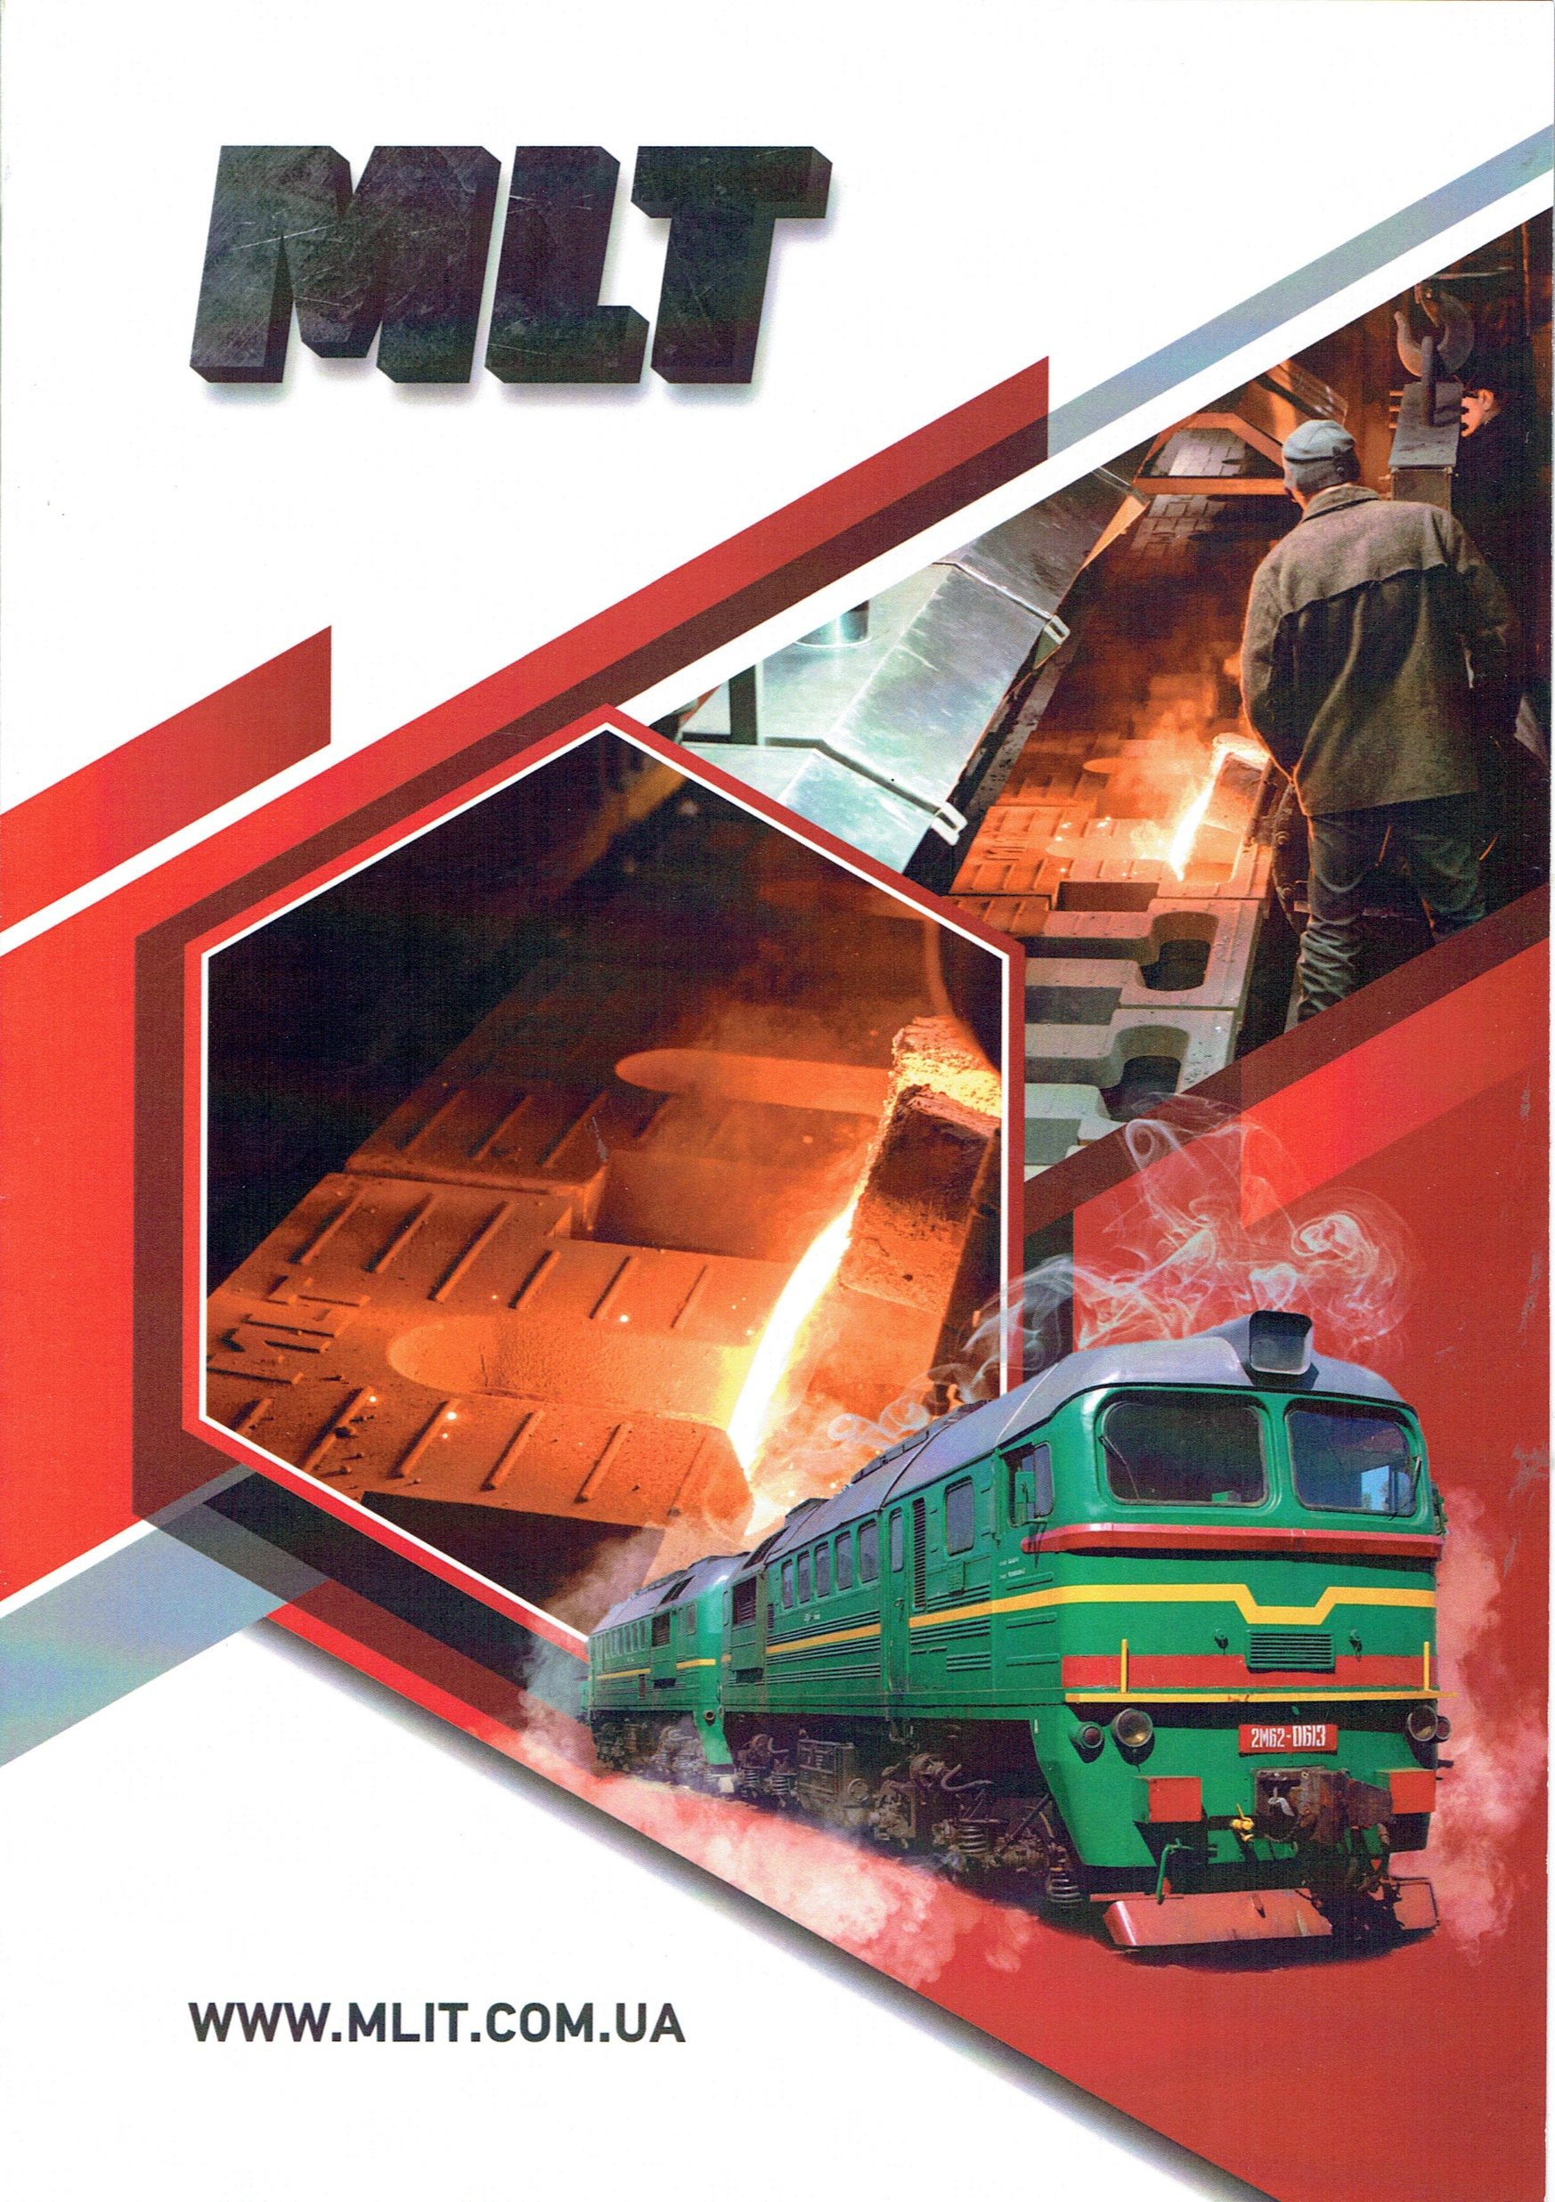
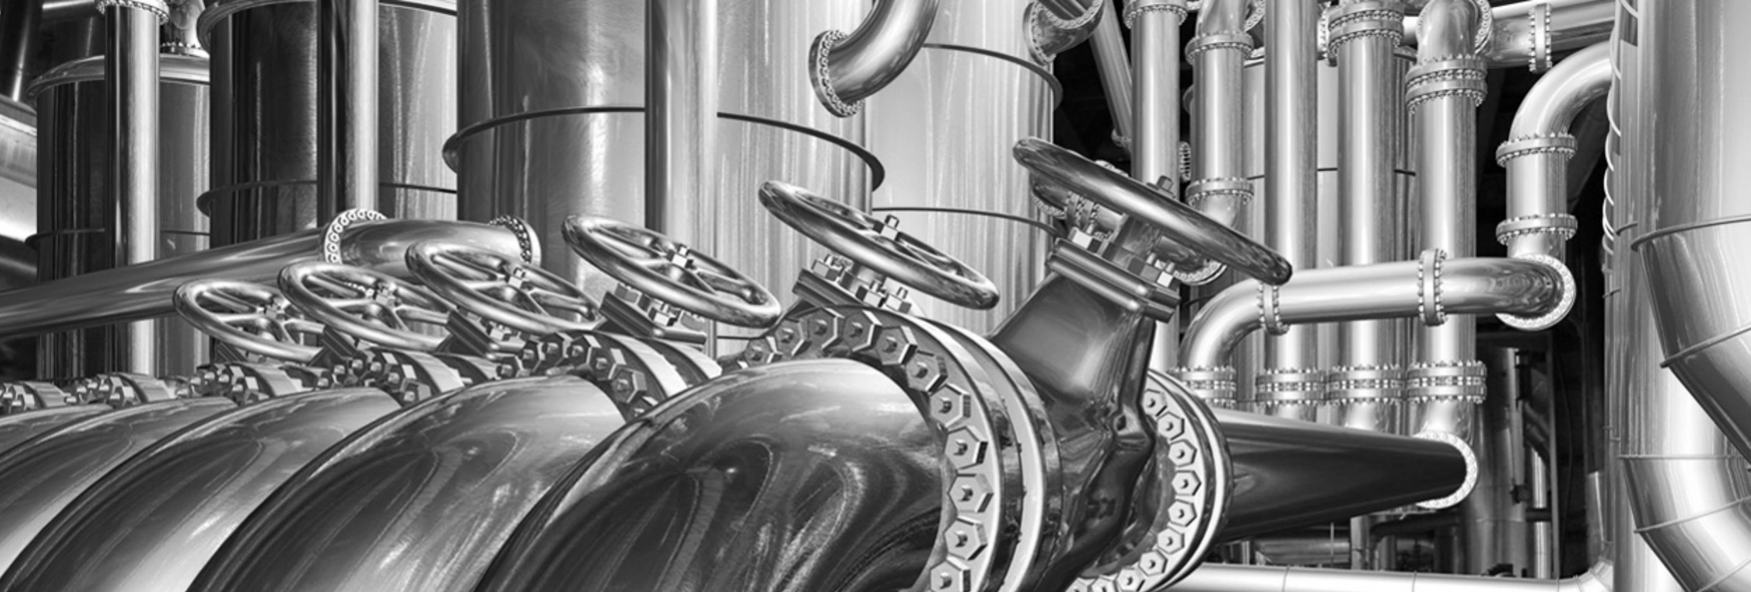

M-LIT at glance

Slide 2

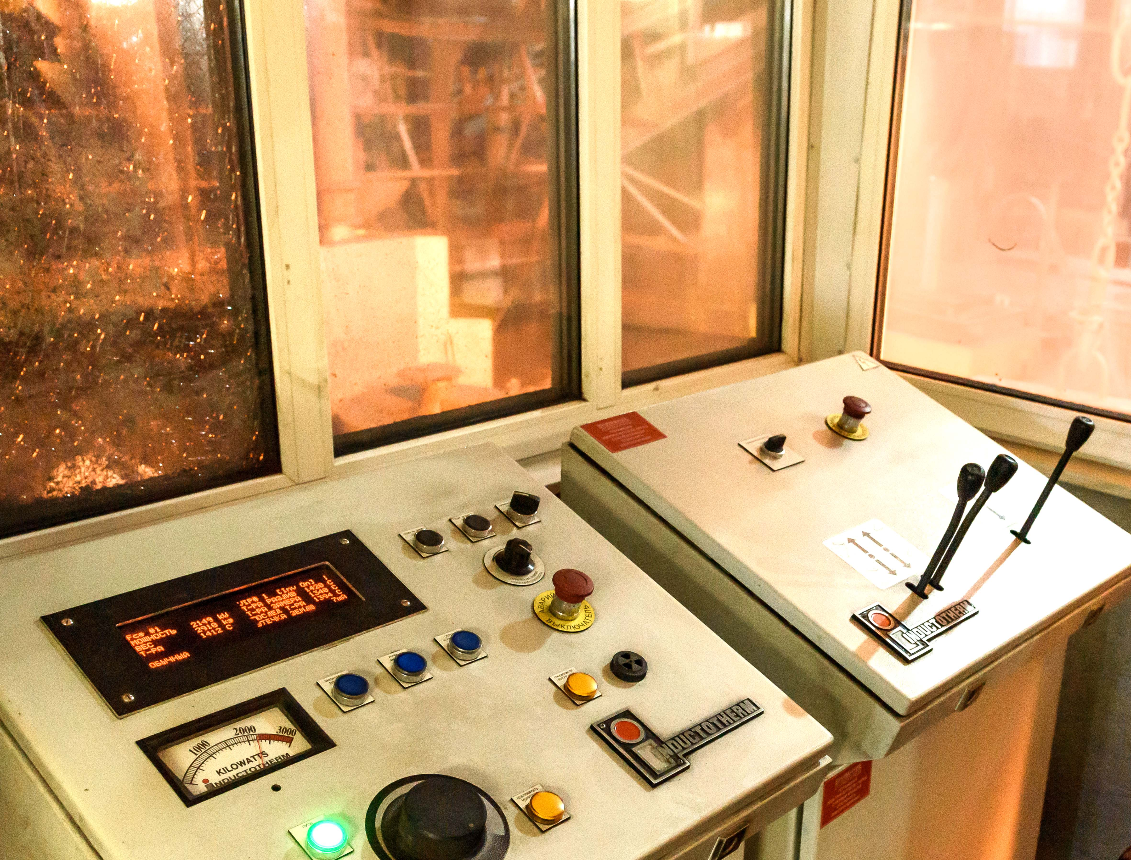
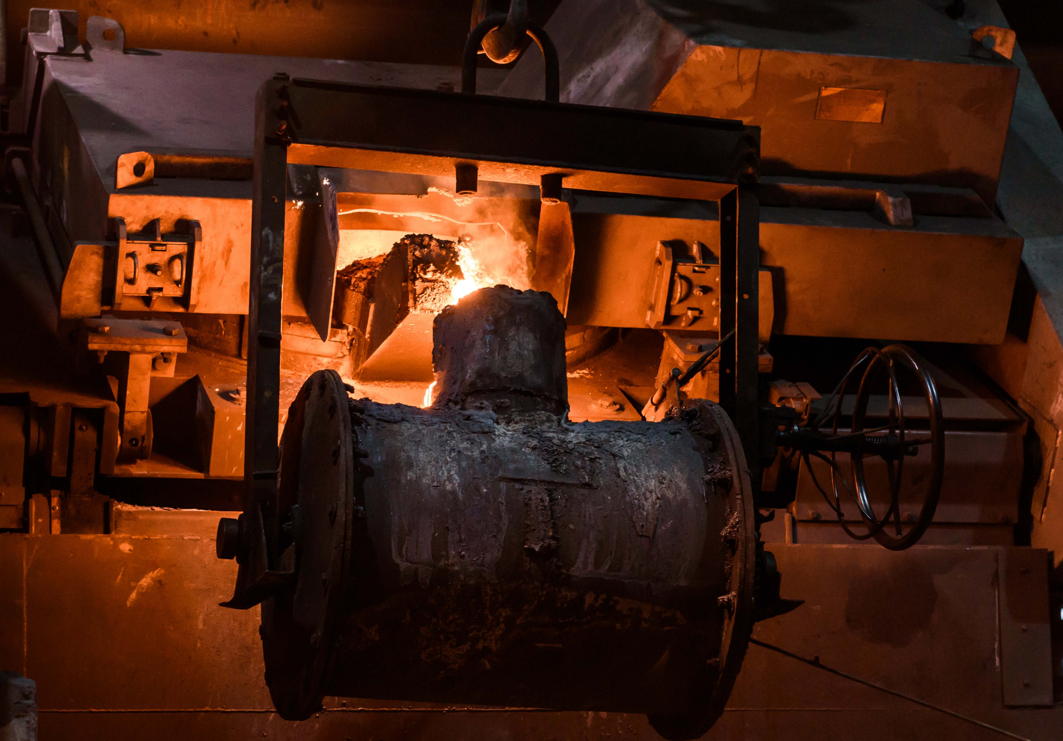
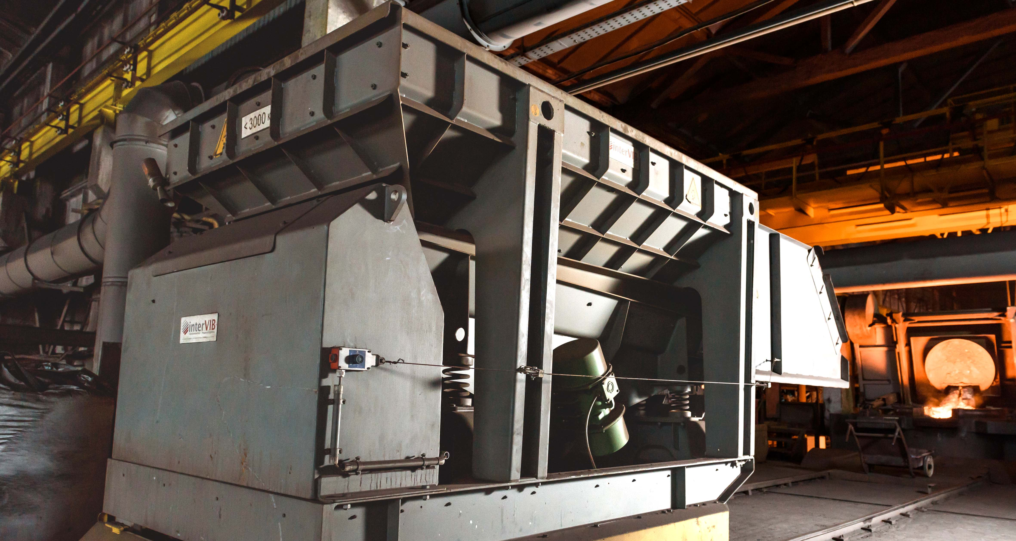
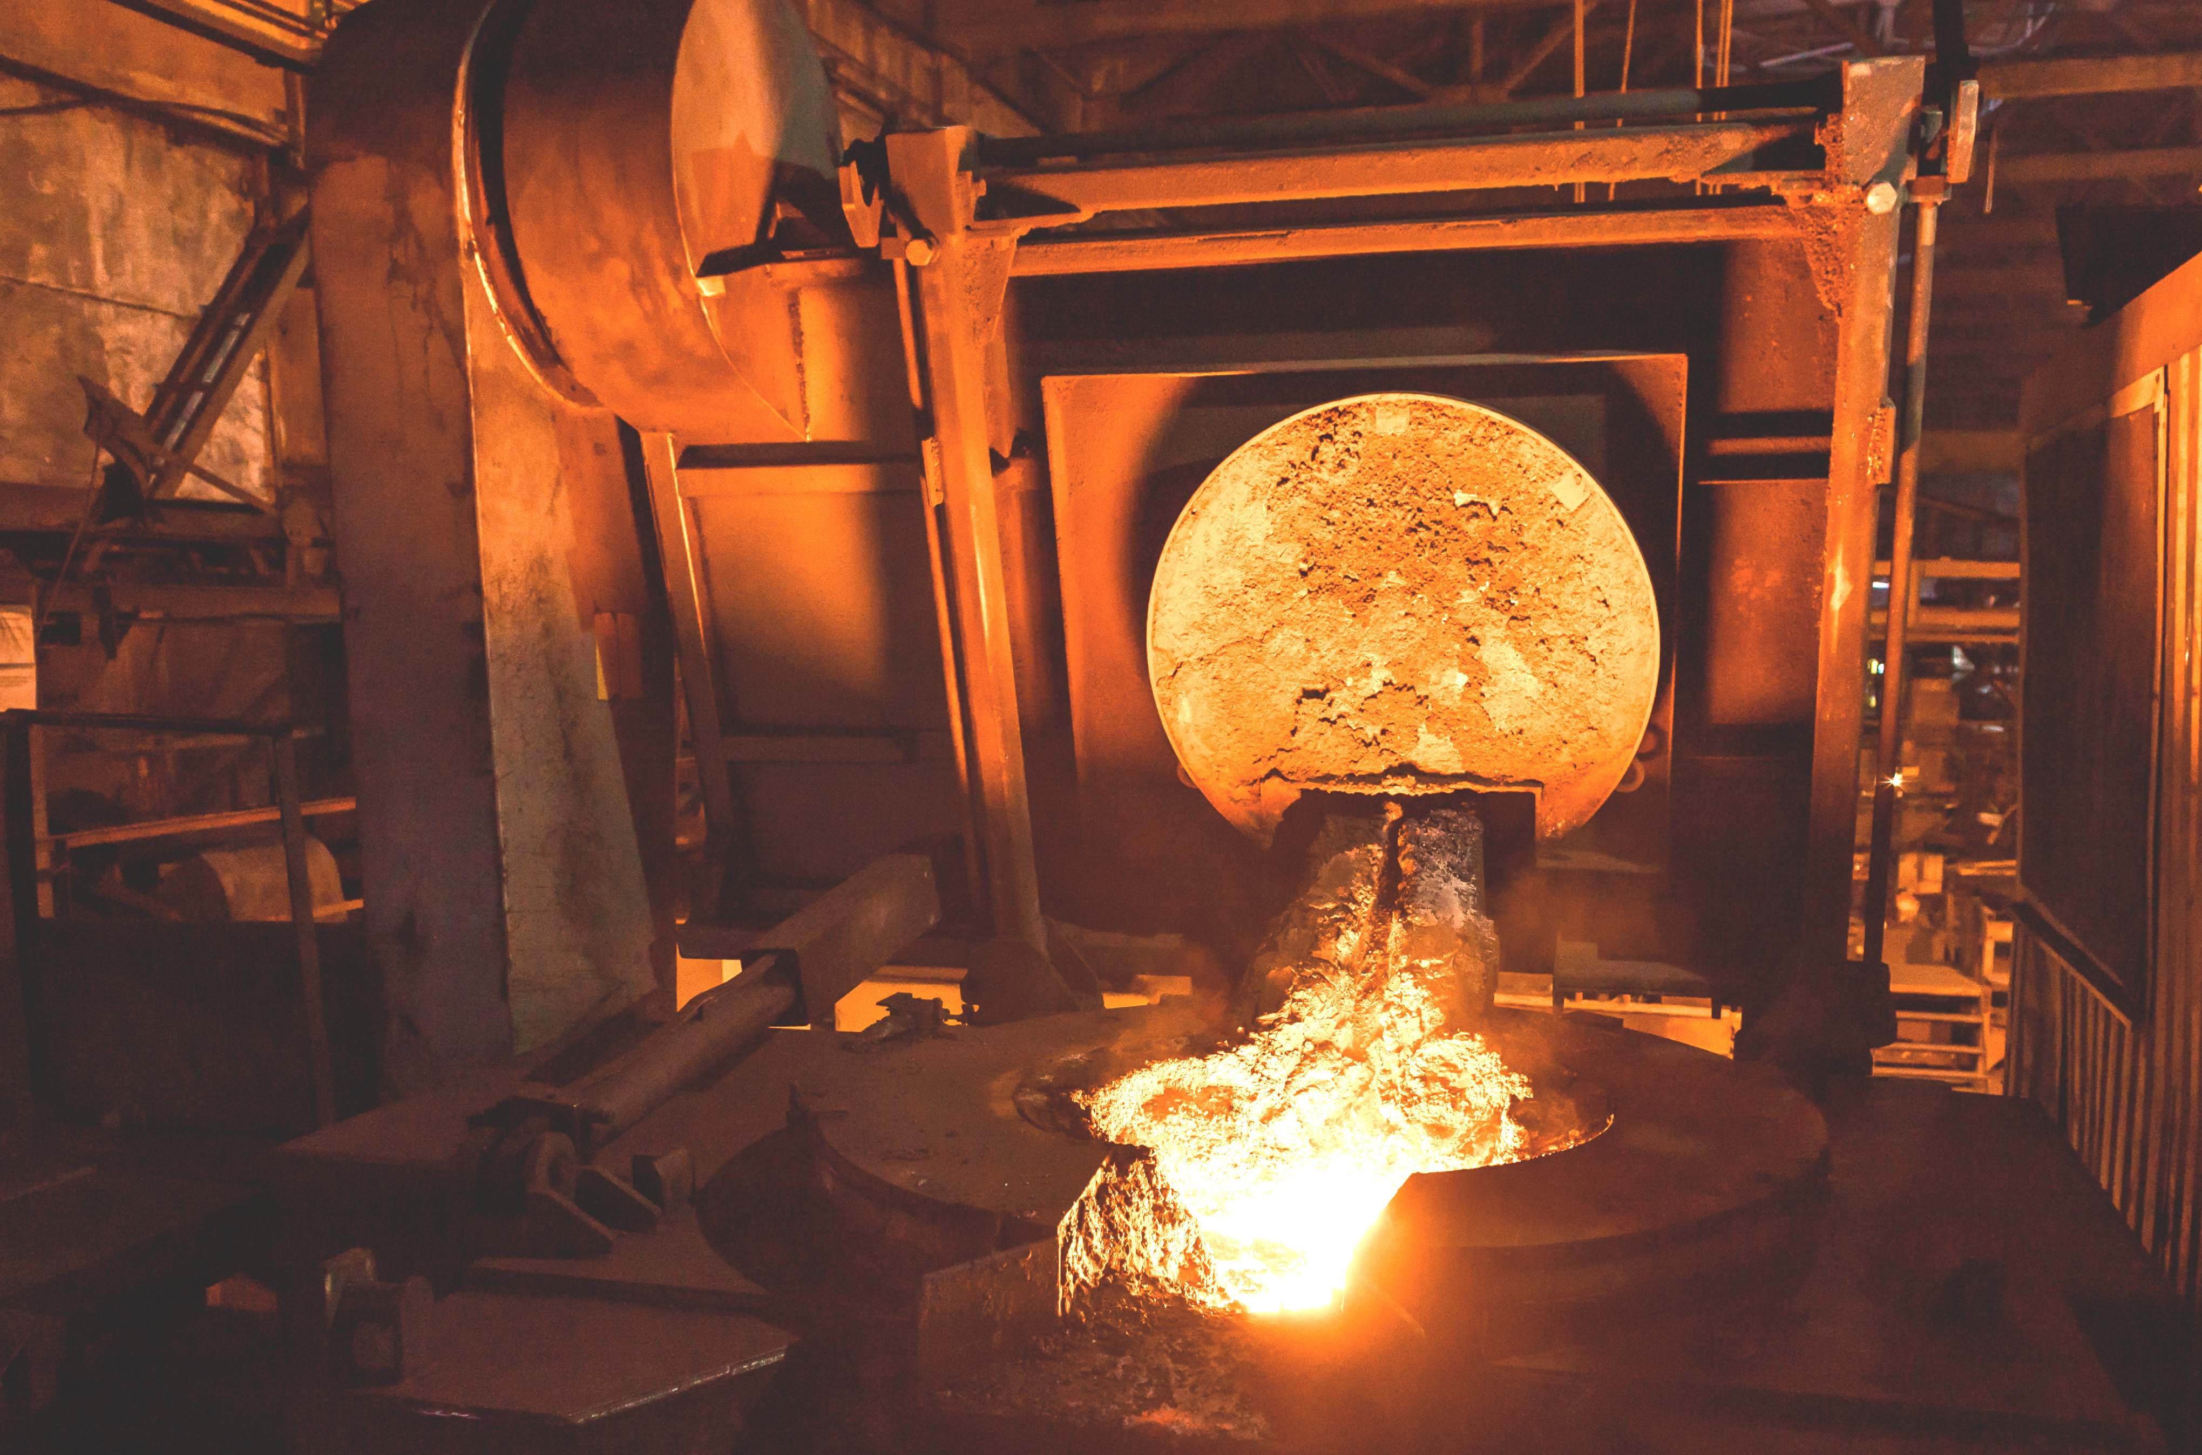
M-LIT: Melting Shop
New 3 tph induction furnace
Automatic loading of raw materials
Heavy-duty top steel plate & tie rods
High-current capacity water-cooled power lids
Grain-oriented shunts
Load cells
Leak detector
Probe assembly
more information under inductotherm.com

Slide 3
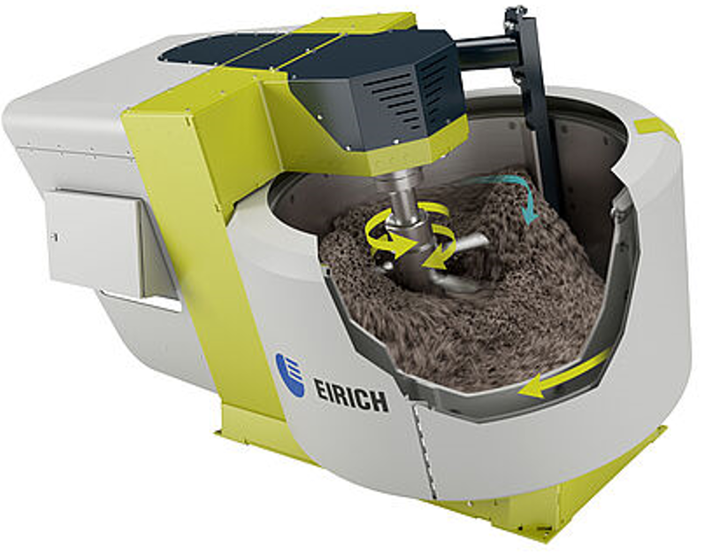
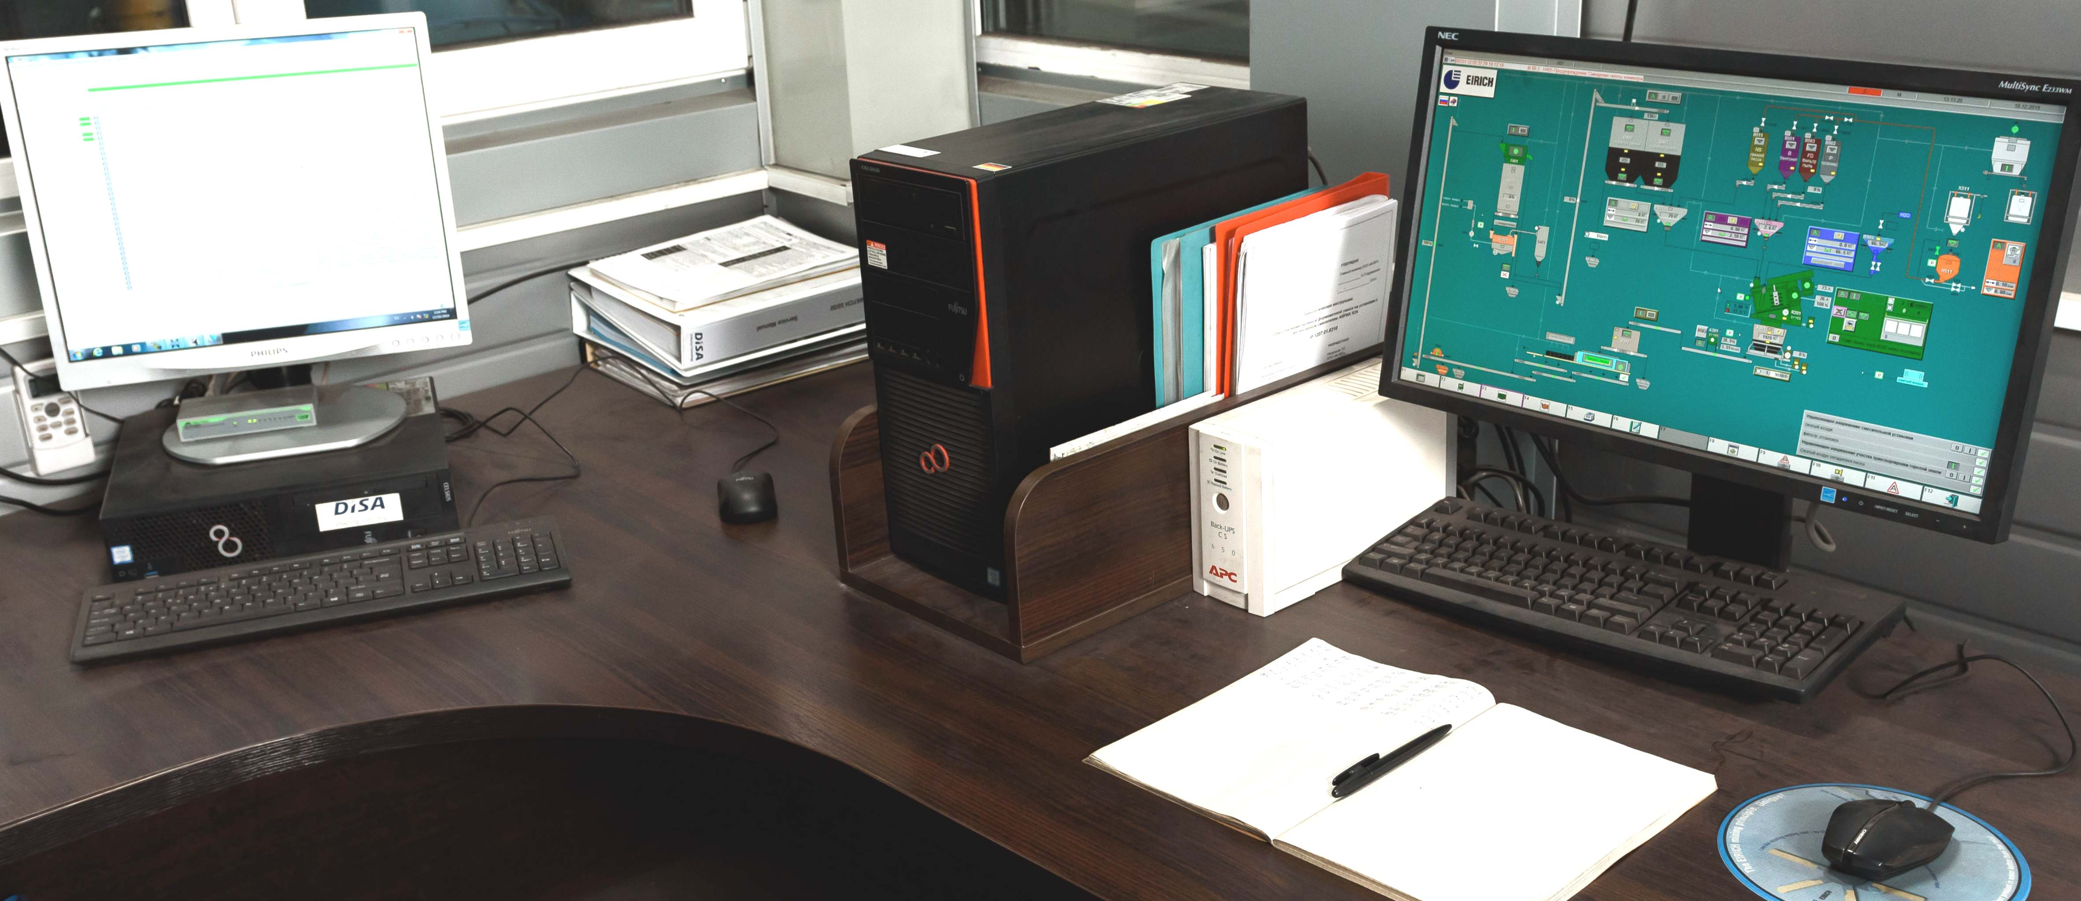

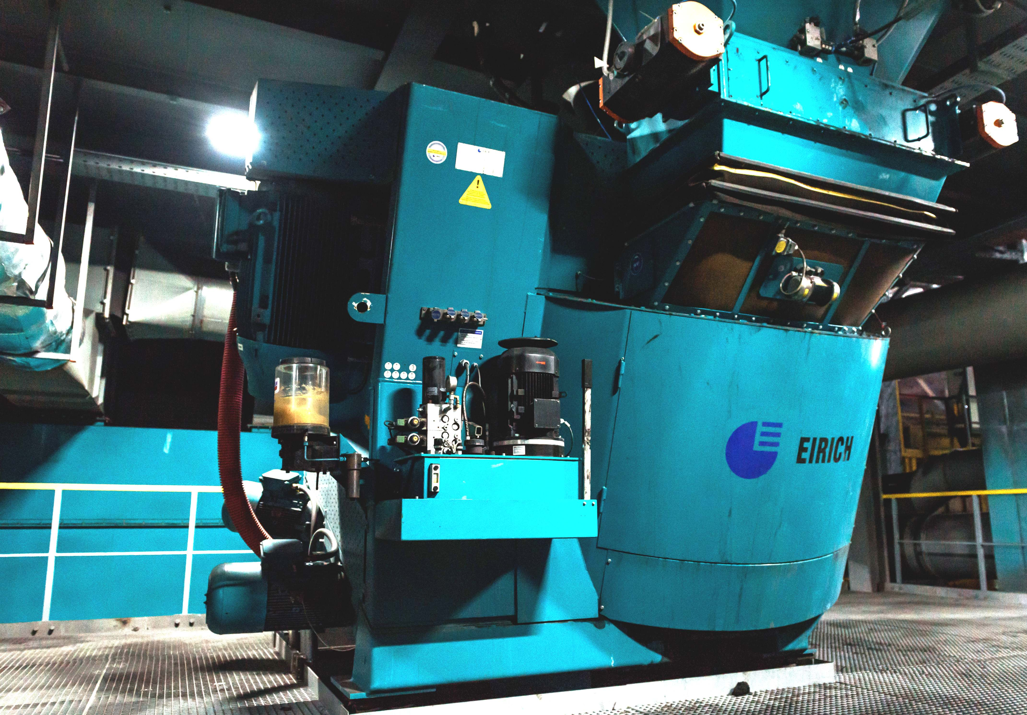
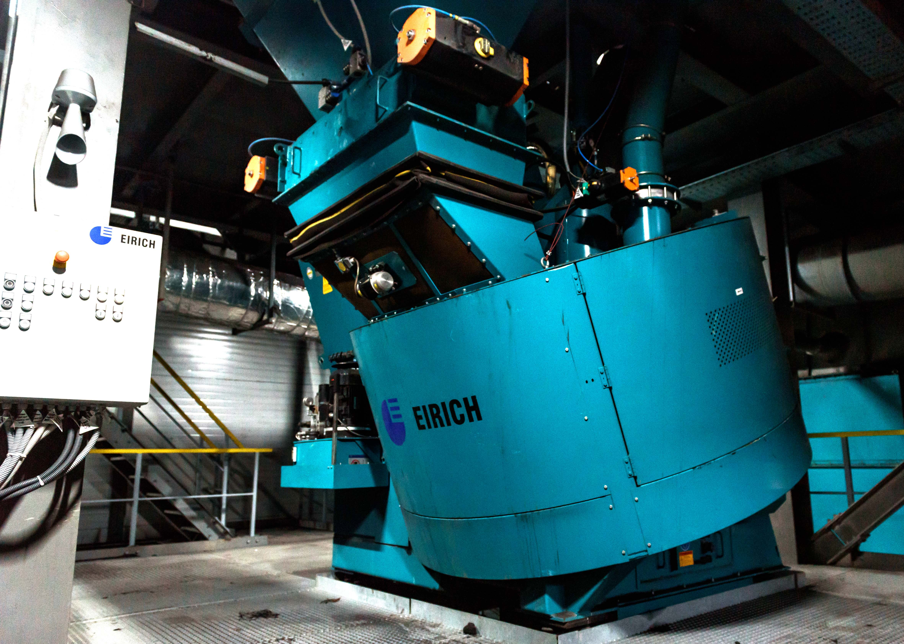
M-LIT: mixture preparation plant
30 t/h - new automatic mixer complex “Eirich”/ Germany
www.eirich.de

Slide 4
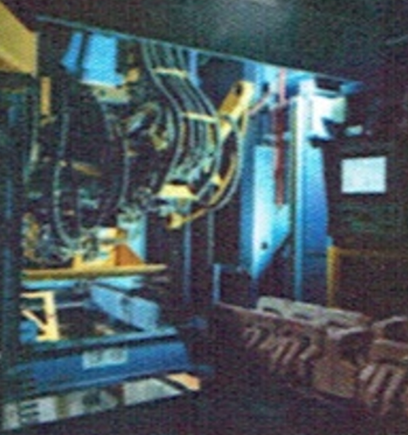
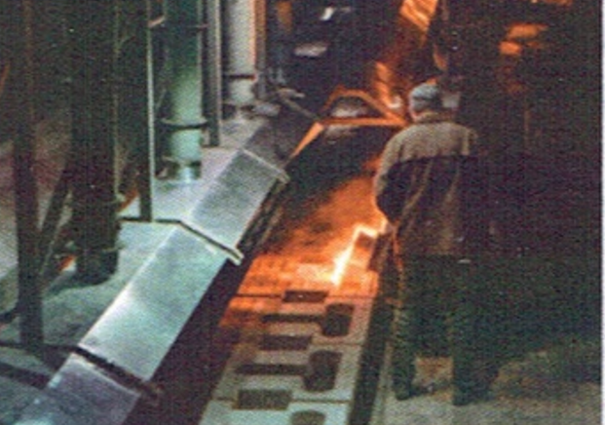
M-LIT: shaping plant
New automatic forming line “DISA MATCH 32x32”
Mould dimensions 813x813x650mm,
Mismatch, max 0.25mm
Machine capacity uncored 100 forms/h
Automatically cored 75 forms/h
Sand consumption max 67 t/h
Ave power consumption 60kw
Connected load 136 kVA
Compressed air 10 Nm3/min
Cooling water 13 l/min
Squeeze pressure 1.2-10bar
Air pressure 5.5bar
Low finishing cost
High speed, fast pattern changes
Adaptive mould thickness control
Very high casting accuracy & repeatability
In-chamber parting spray system prevents sand sticking to the pattern plate
Patented sand slot design for optimum mould quality
Optimized cycle time thanks fully adjustable stripping height
Constant sand-metal ratio with adaptable mould height

Slide 5
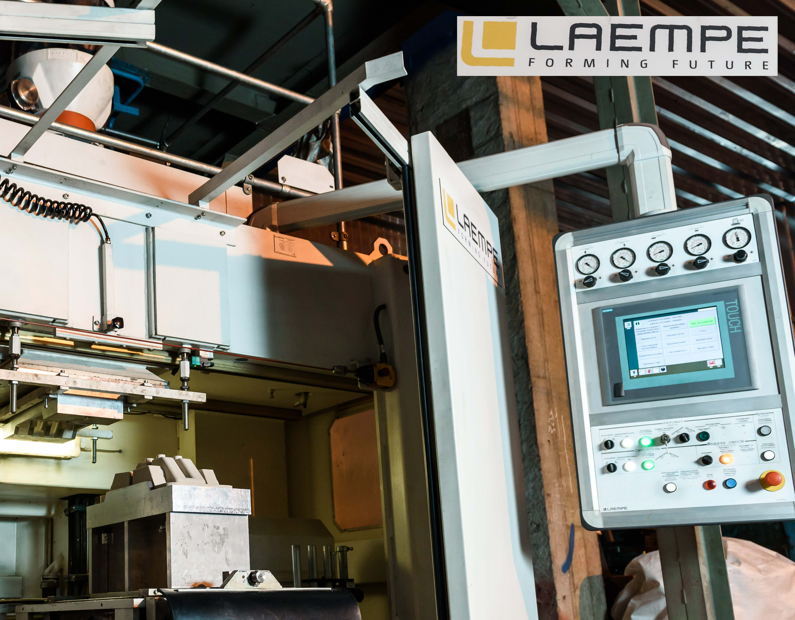
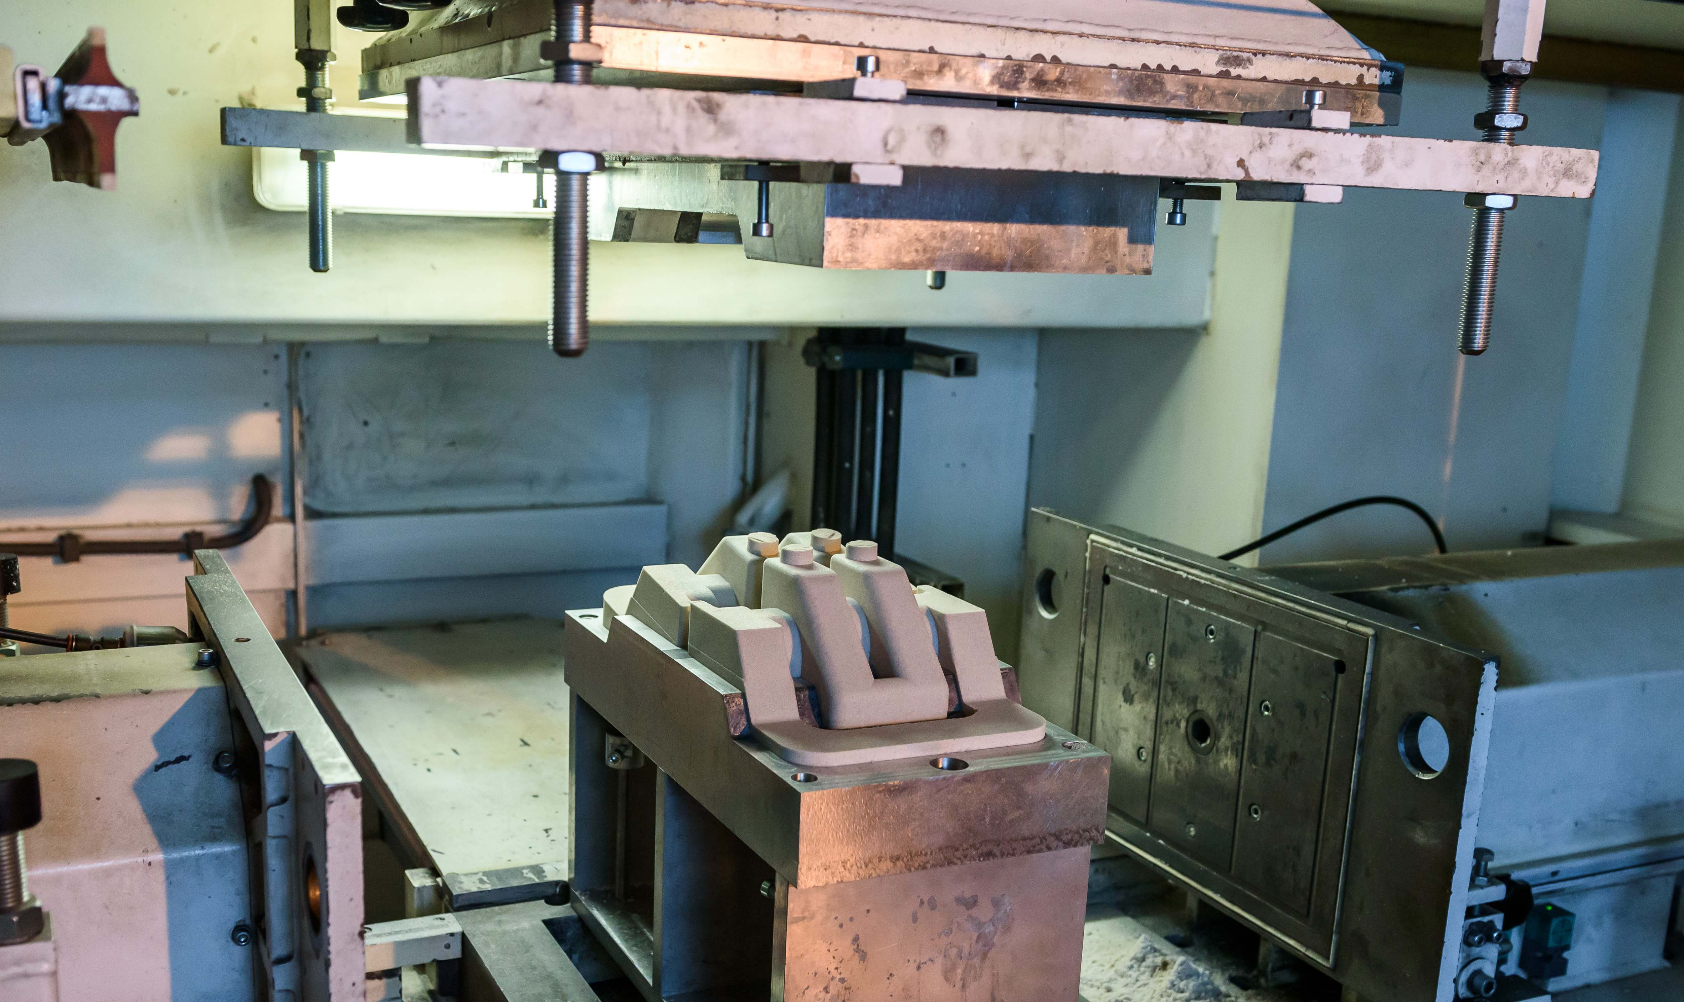
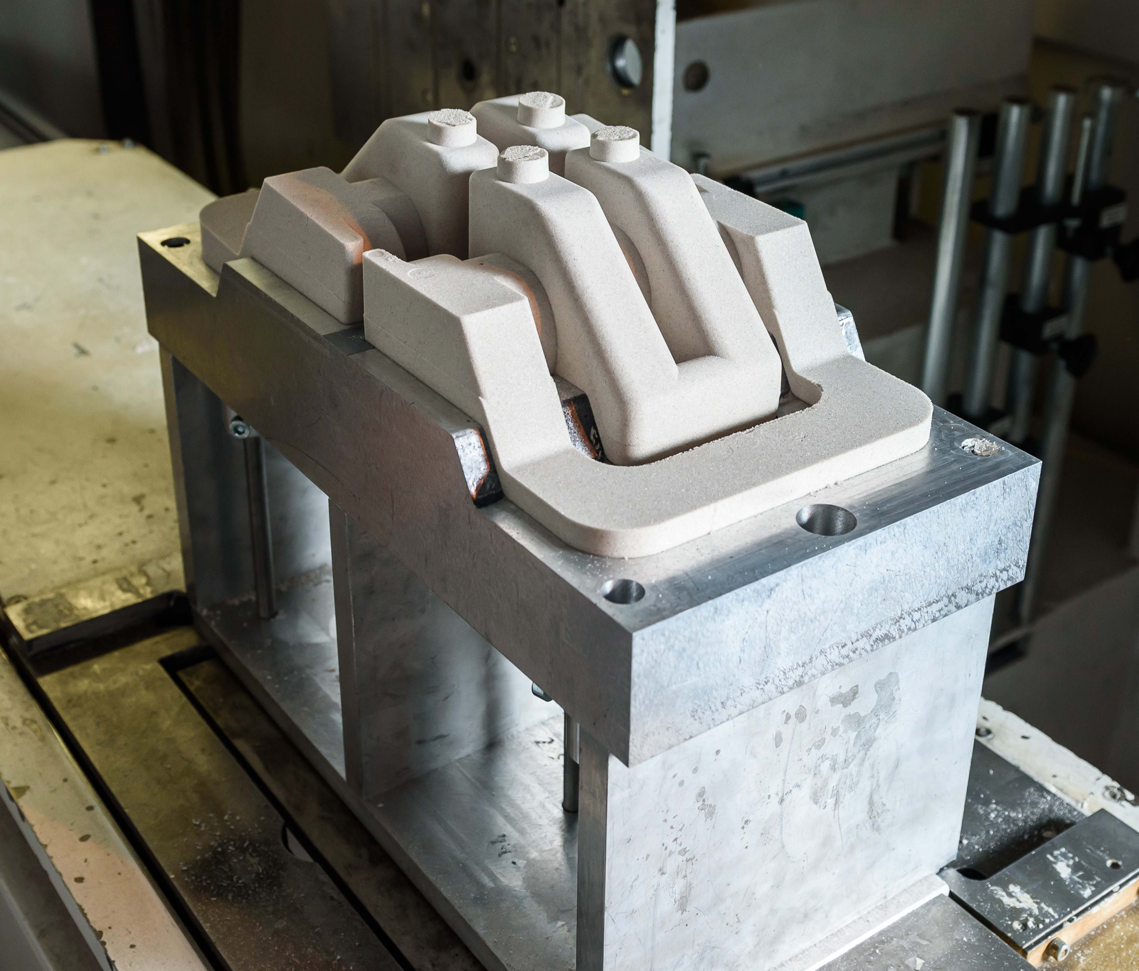
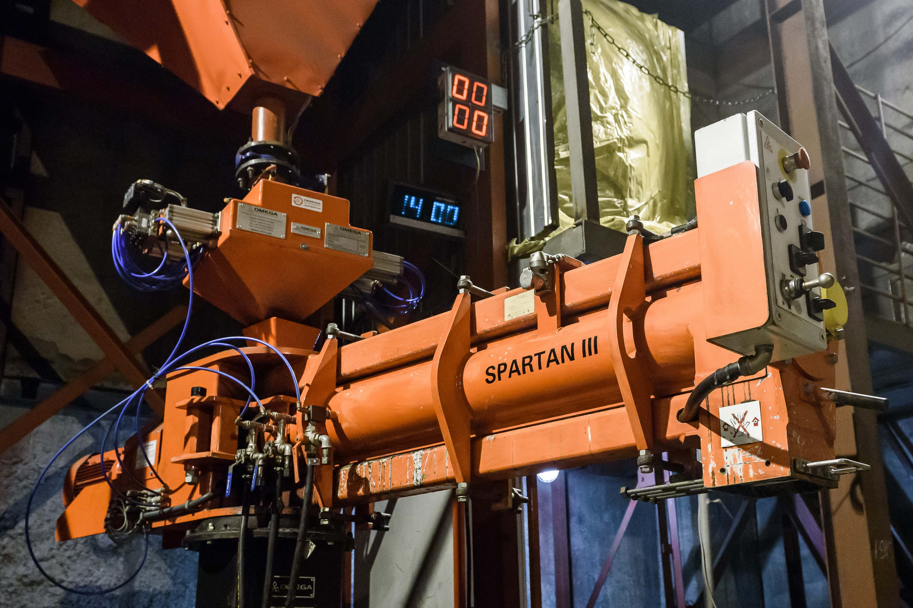
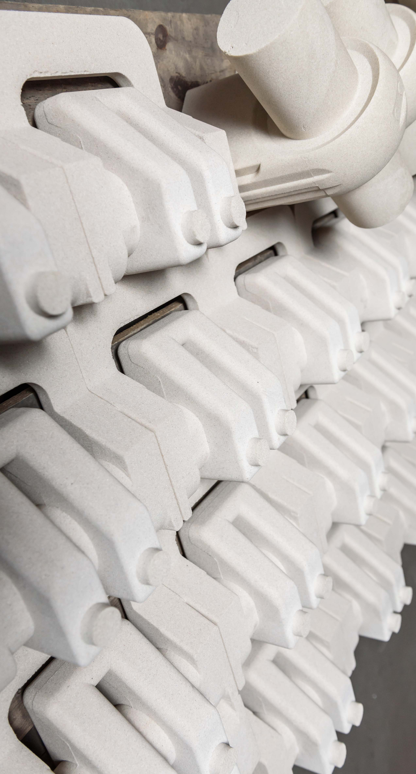
M-LIT: rod preparation equipment
New rod machines “LAEMPE”/ Germany
“Cold-box”-process
Section of large rods made by Omega Foundry Machinery /UK
Hot & cold core hardening processes
Shoot volume up to 200 liters
Multiple blow head
Suitable for processing tools with up to 6 parts
Automatic tool change
Gas hood with integrated ejection plate
Progressive central lubrication
User friendly control system with automatic fault diagnostics
Tool changer – available for LHL30/50 and LFB
www.laempe.com

Slide 6

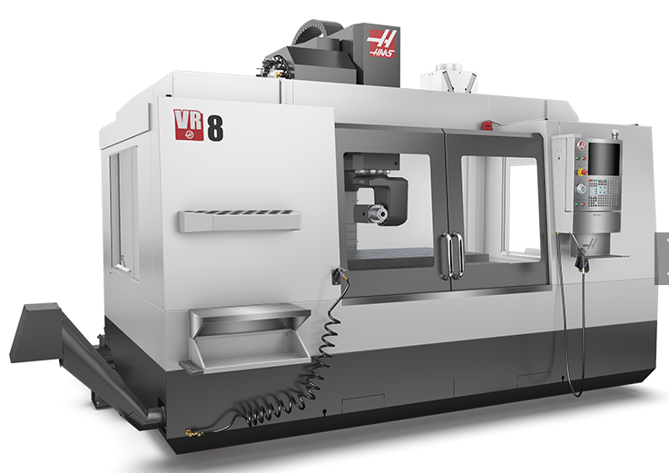
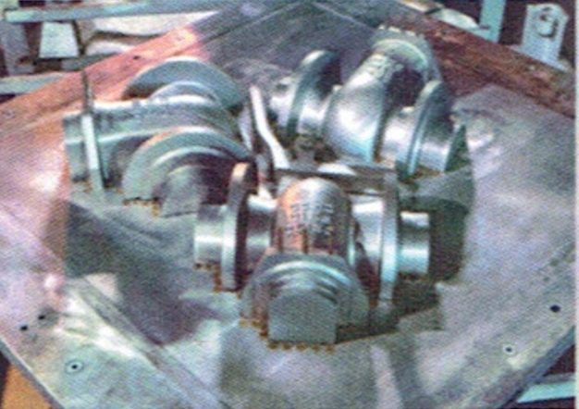
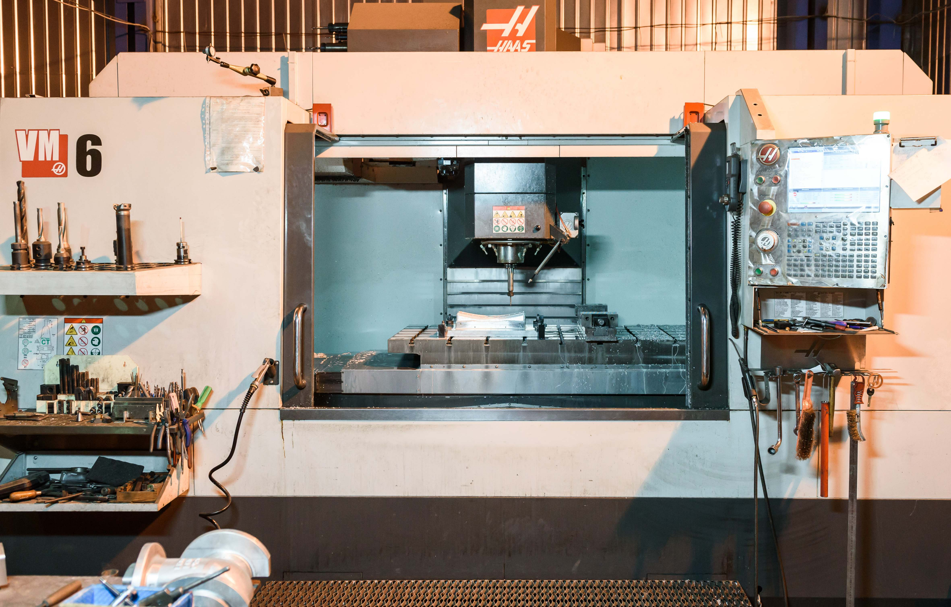
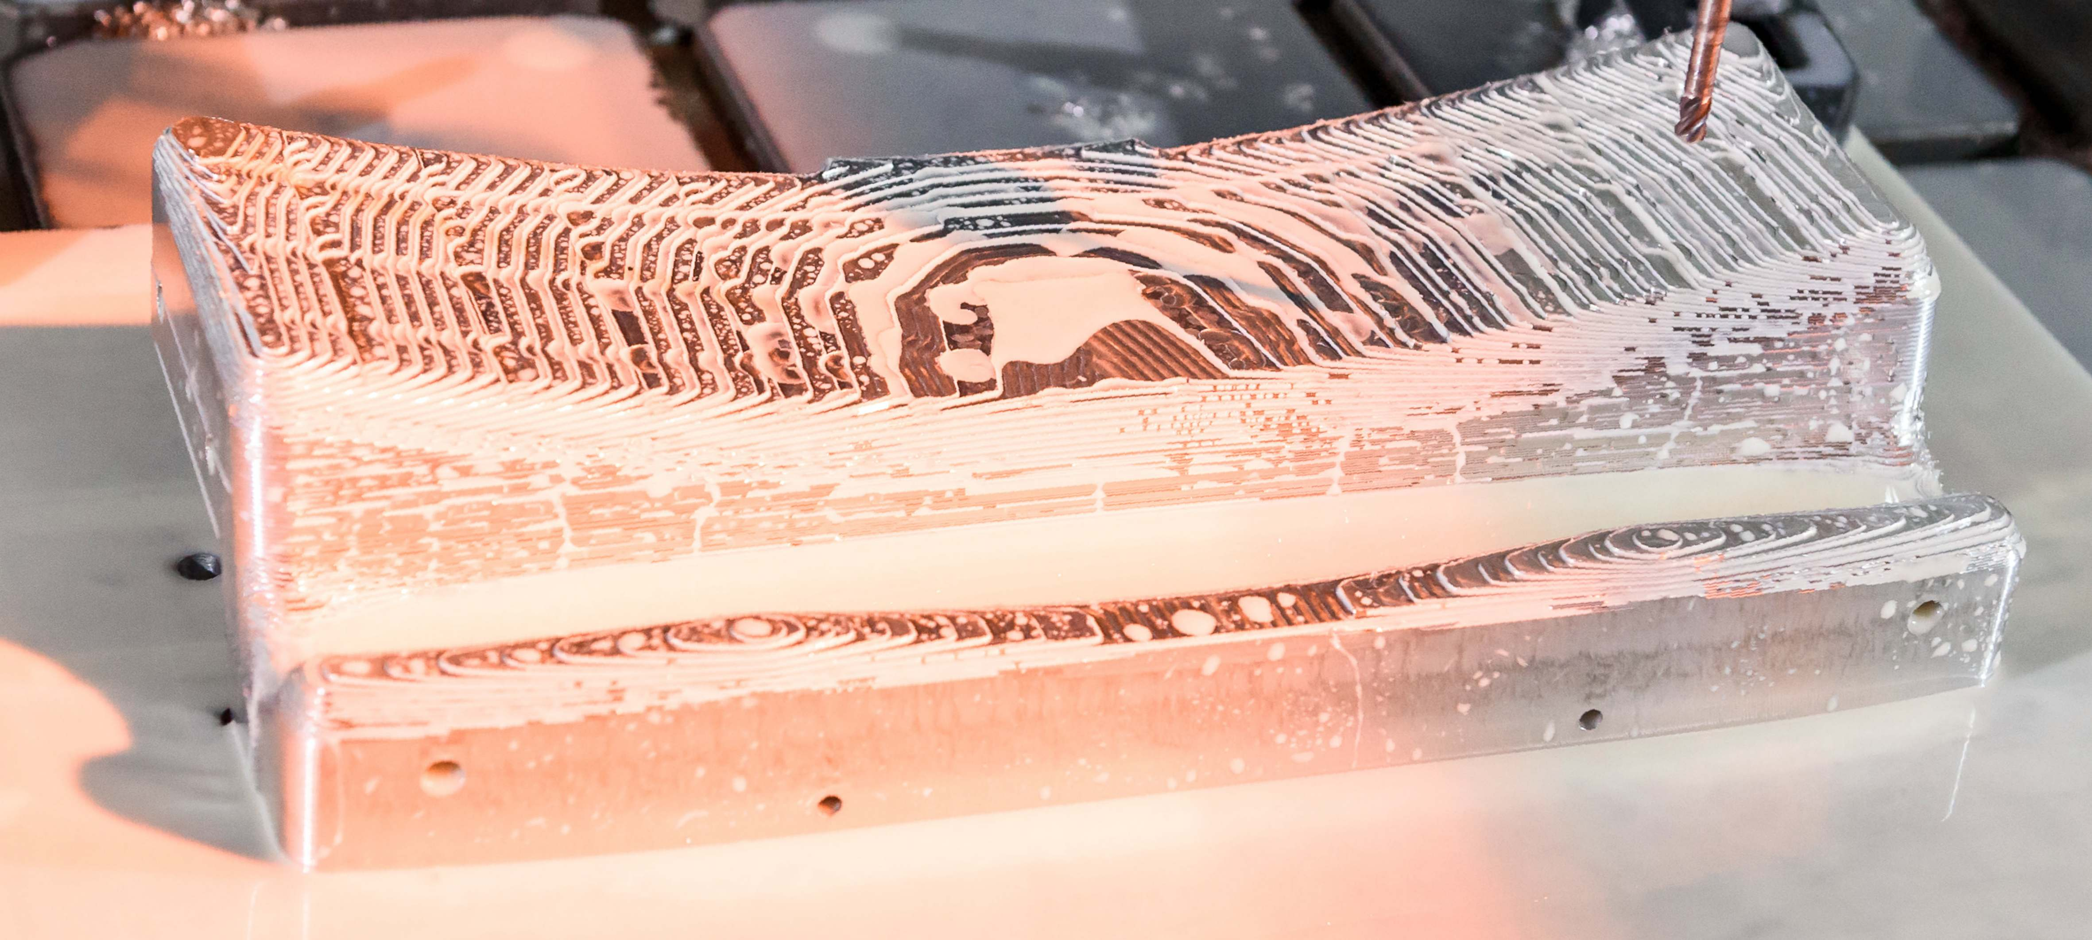
M-LIT: model shop
New model molds machine by HAAS / USA
Best-in-class equipment for the production of rods and model molds by HAAS/ USA
www.haascnc.com

Slide 7
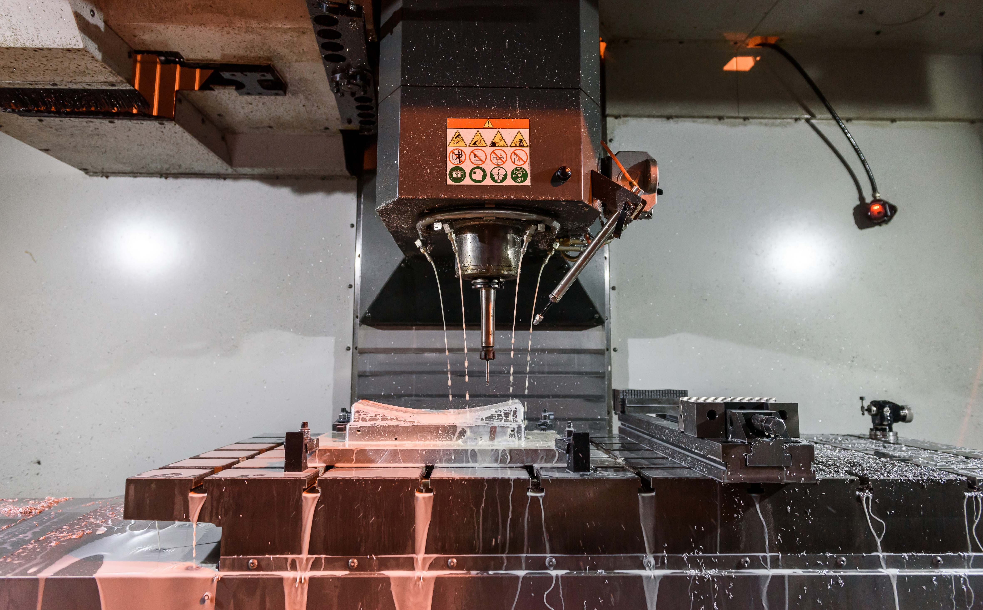
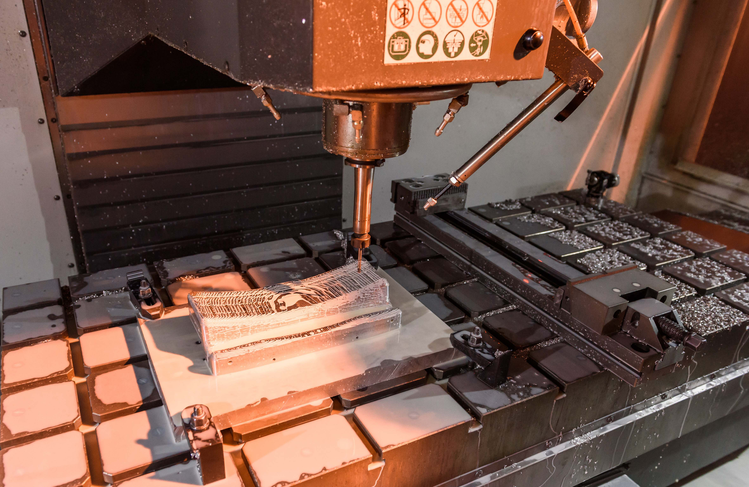
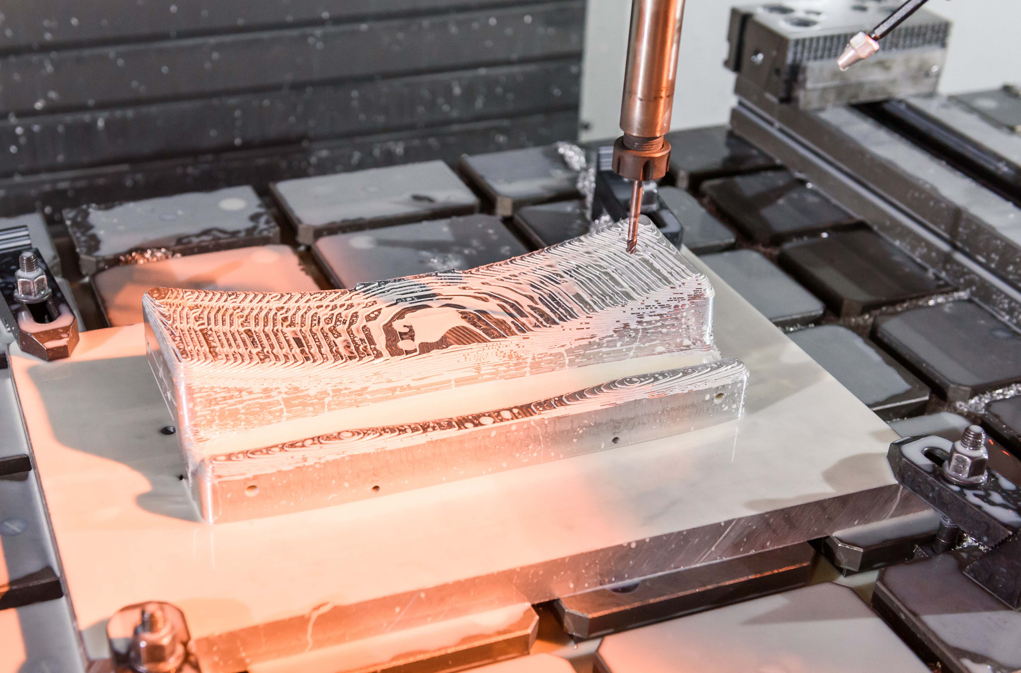
M-LIT: model shop

Slide 8
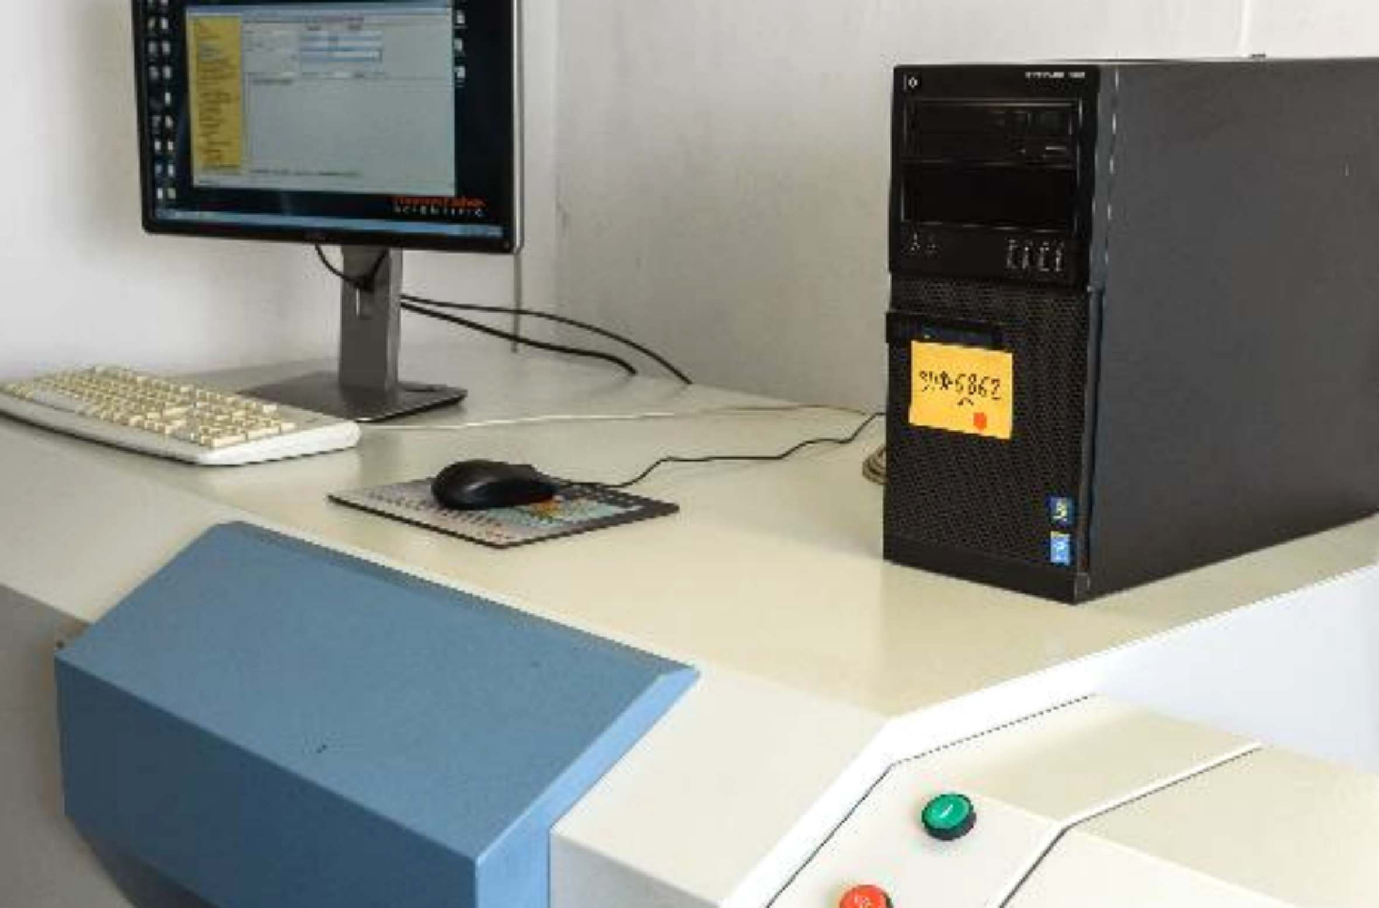

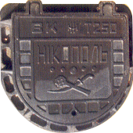
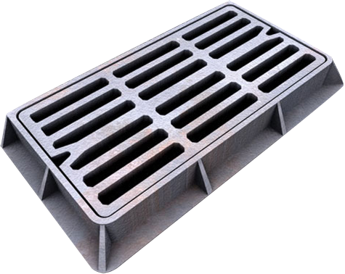
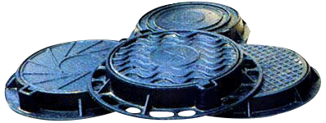
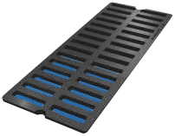
M-LIT: metal quality control
State-of-the-art spectral laboratory
ARL 3460 /Swiss, made by

Slide 9
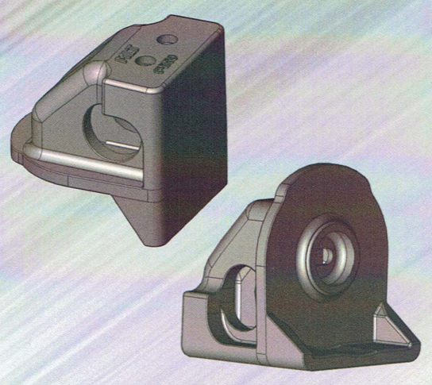
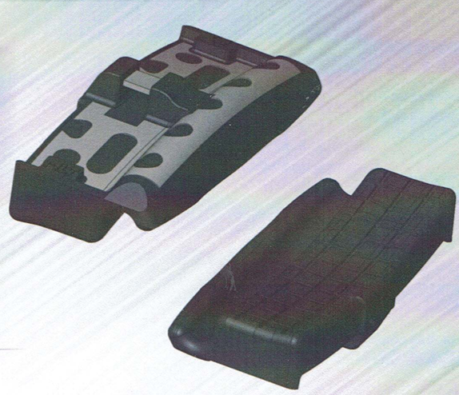
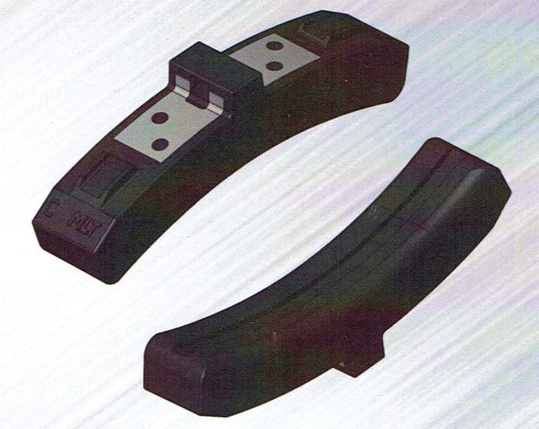
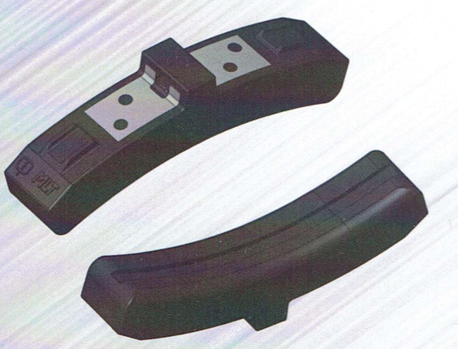
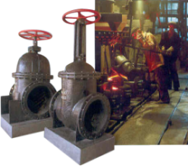
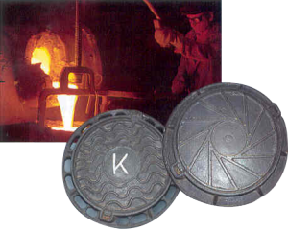
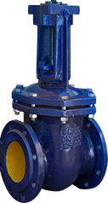
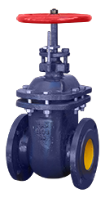
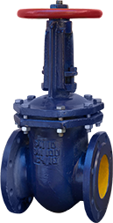
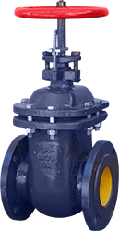
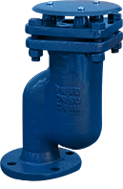
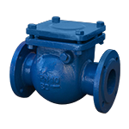
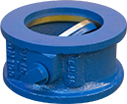
M-LIT: gate valves, sewage covers

Slide 10
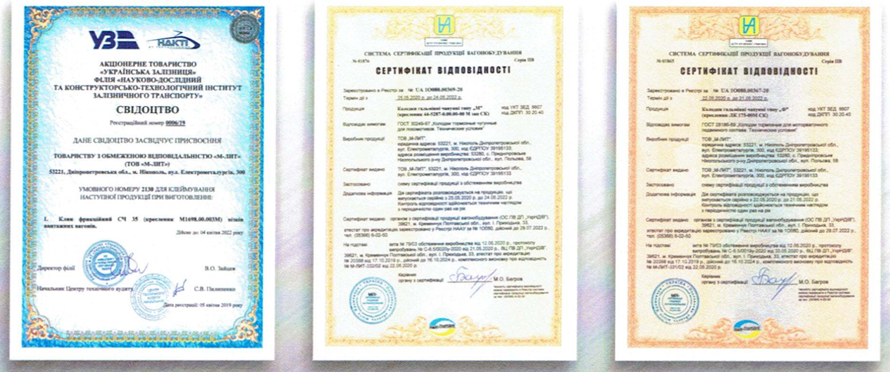
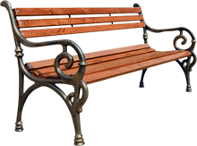
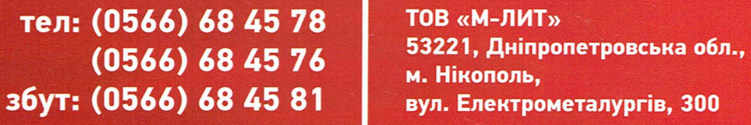
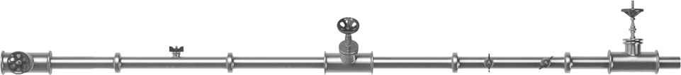
M-LIT: prooven quality for your needs

